Slide 1



AI TEAMWORK
2020-2021
TEAM: SMALL-CARE

Slide 2
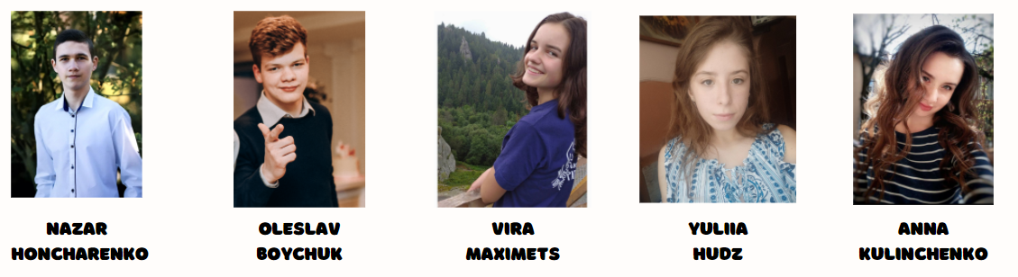
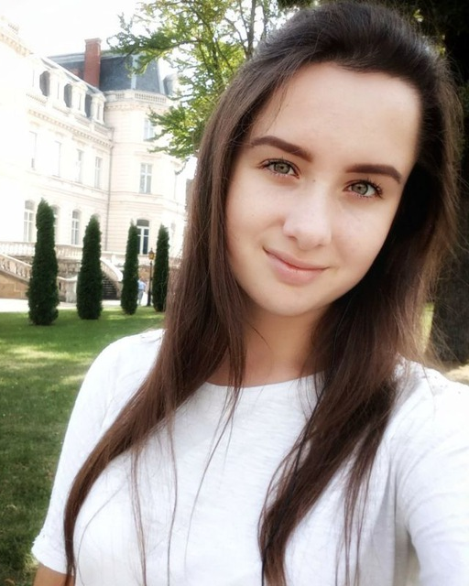
OUR TEAM
SMALL-CARE

Slide 3
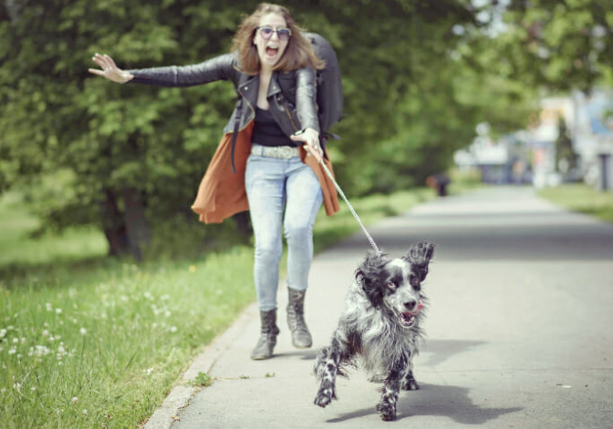
PRODUCT IDEA OVERVIEW
PROBLEM
- some dog owners don't have enough time for daily and regular walking
- lack of time for visits to the vet
- disability to travel with some animals
SOLUTION
Pet owners will be able to easily and quickly find a helper
who will take care of their pets and will do some routine work.

Slide 4
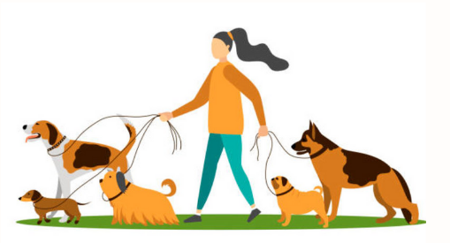
PROJECT SCOPE OVERVIEW
October
Discuss the details of the project
Create project documentation
Choose technological stack
November
Create models and connections
Change technological stack, rewrite the project
Create main pages of the website
December
Registration and authorization
Adding main functionalities
Enable a user to see all his events and animals
Create a logo
January
Adding internationalization
February
Work on the website front-end and bugs fixing

Slide 5



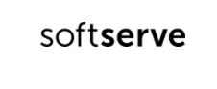
SOFTWARE DEVELOPMENT PROCESS
PROJECT STAGES
thinking over various project ideas and choosing the best one
observing the existing similar services in order to create unique one
analyzing the project architecture and functionality
division of the project into different parts and setting deadlines
choosing technologies
team members role assignment
working on the project that includes planning, self-learning, development, quality assurance, design solutions and bugs fixing
COMMUNICATION AND TASK MANAGEMENT
During the lifetime of project development our team have been using Jira to monitor the process of performing all tasks.
Weekly meetings in Google Meet to see if all team members are up to the task and don`t have problems with them.
Every day each team member writes about:
Things I have done since yesterday's meeting
Things I am going to get done today
Problems I have

Slide 6






TECHNOLOGICAL STACK

Slide 7
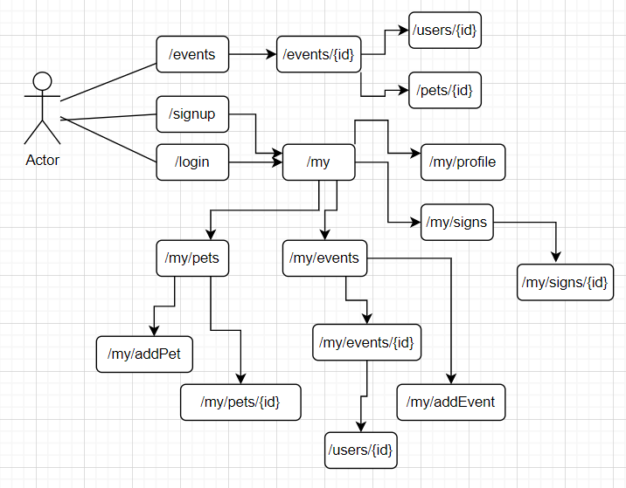
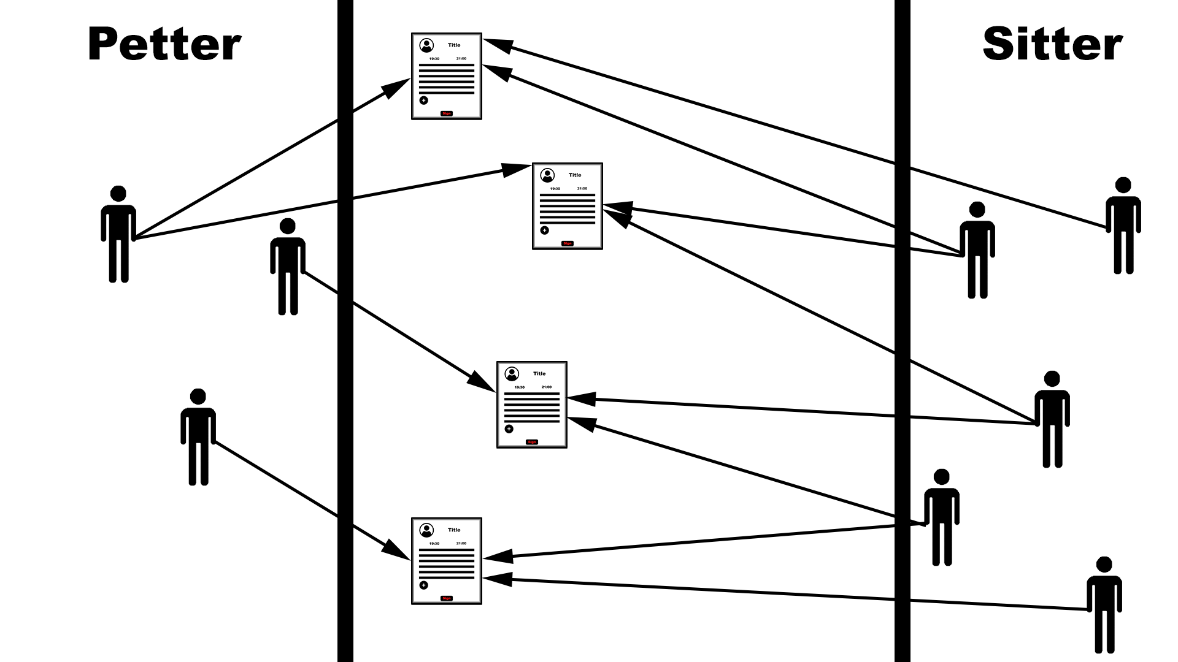
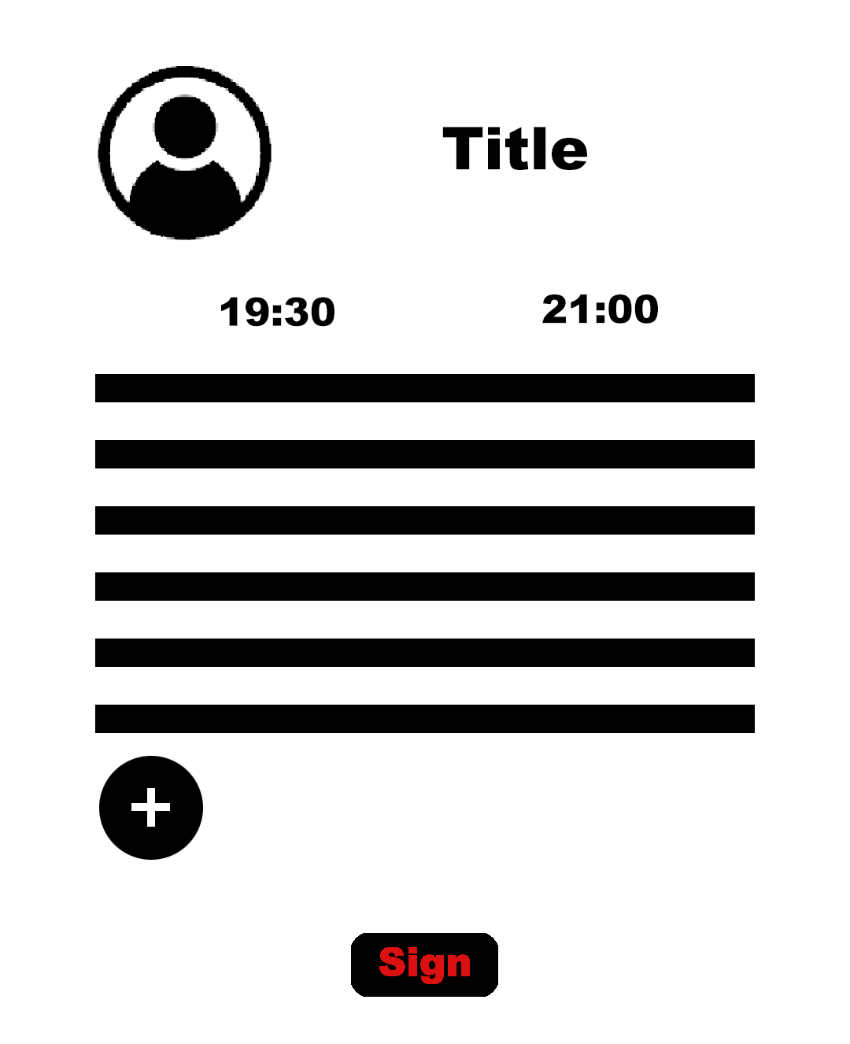
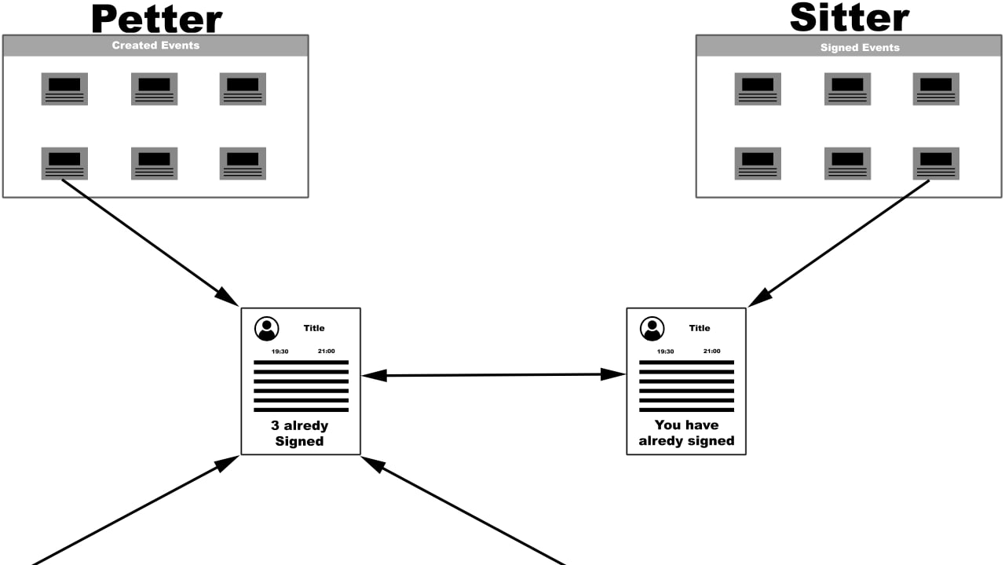
APPLICATION ARCHITECTURE

Slide 8
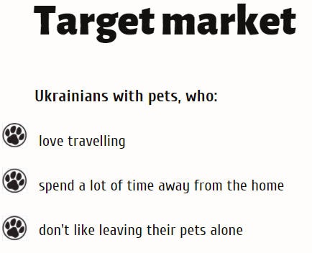
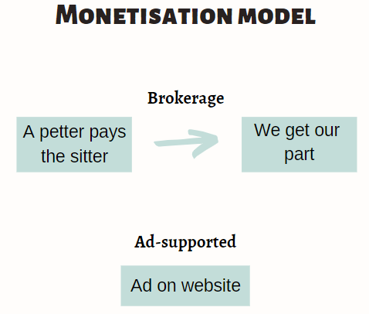
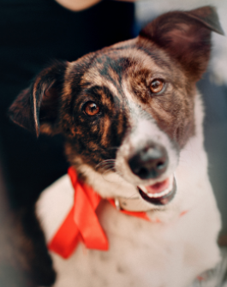
PRODUCT BUSINESS VALUE

Slide 9
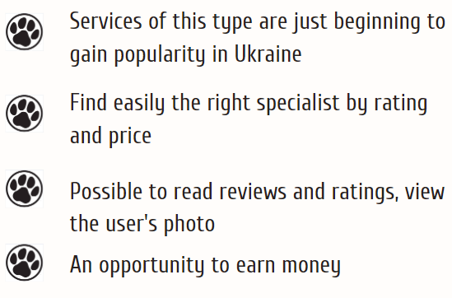
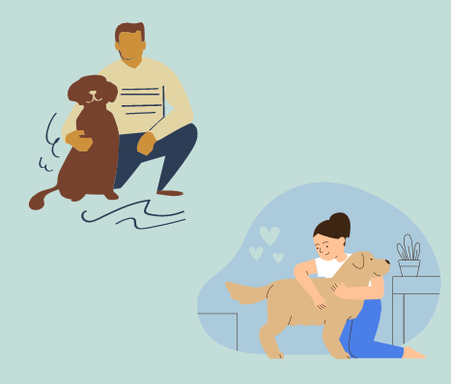
PRODUCT BUSINESS VALUE

Slide 10

DEMO

Slide 11
QUESTIONS?

Slide 12


